Slide 1
PSYCHOLOGICAL PSEUDOSCIENCE
Sheldon W. Helms

Slide 2
Psychological Pseudoscience
1. use of vague, contradictory, exaggerated, or un-provable claims.
2. over-reliance on confirmation.
3. lack of openness to evaluation.
4. absence of systematic processes to develop theories.

Slide 3
Psychological Pseudoscience
FRINGE PSYCHOLOGY
MAINSTREAM PSYCHOLOGY
BAD TEACHING AS PSEUDOSCIENCE

Slide 4
Psychological Pseudoscience
FRINGE PSYCHOLOGY
MAINSTREAM PSYCHOLOGY
BAD TEACHING AS PSEUDOSCIENCE

Slide 5
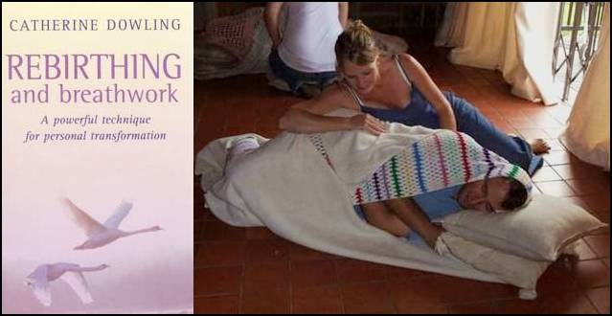
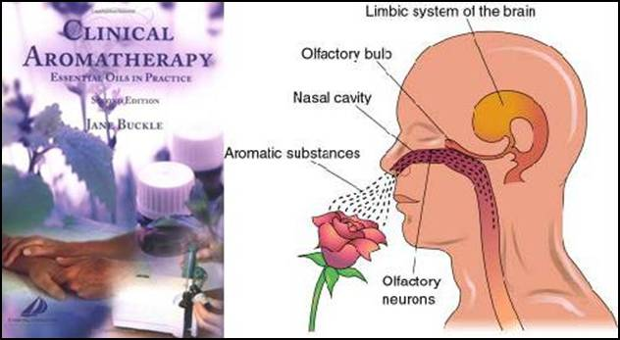
FRINGE PSYCHOLOGY
Rebirthing Therapy
Aroma-Therapy

Slide 6
FRINGE PSYCHOLOGY
Rebirthing Therapy
Aroma-Therapy
Primal Scream
Therapy

Slide 7
FRINGE PSYCHOLOGY
PTSD
Posttraumatic Stress Disorder

Slide 8
FRINGE PSYCHOLOGY
PTSD
Posttraumatic Stress Disorder
Cognitive-Behavioral Therapy
- Exposure
- Cognitive Therapy
- Anxiety Management Training

Slide 9
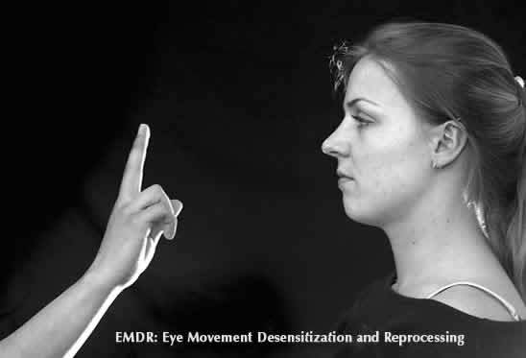
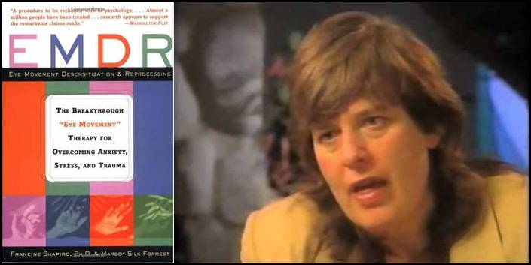
FRINGE PSYCHOLOGY
EMDR
Eye Movement Desensitization and Reprocessing
Dr. Francine Shapiro

Slide 10
FRINGE PSYCHOLOGY

Slide 11
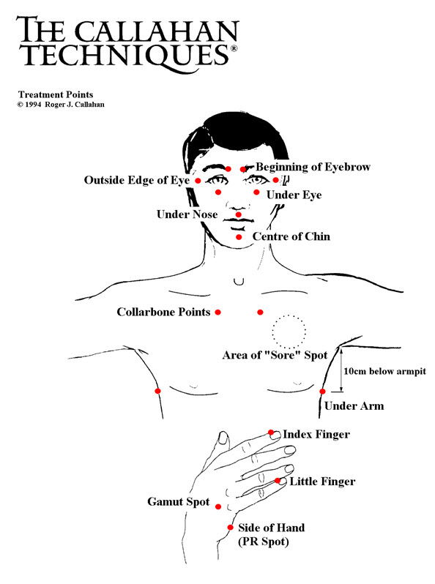
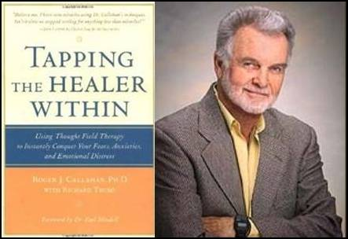
FRINGE PSYCHOLOGY
TFT
Thought-Field Therapy
Dr. Roger Callahan

Slide 12
FRINGE PSYCHOLOGY

Slide 13
FRINGE PSYCHOLOGY
Comparison of PTSD Therapies
 | Cog-Behavioral Therapy | EMDR | TFT
Exposure | X | X | X
Cognitive Therapy | X | X | X
Anxiety Mgmt. | X | X | X
Eye Movements |  | X
Body Tapping |  |  | X

Slide 14
FRINGE PSYCHOLOGY
Comparison of PTSD Therapies
 | Cog-Behavioral Therapy | EMDR | TFT
Exposure | X | X | X
Cognitive Therapy | X | X | X
Anxiety Mgmt. | X | X | X
Eye Movements |  | X
Body Tapping |  |  | X

Slide 15
MAINSTREAM PSYCHOLOGY

Slide 16
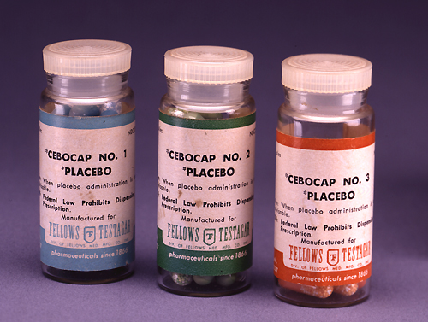
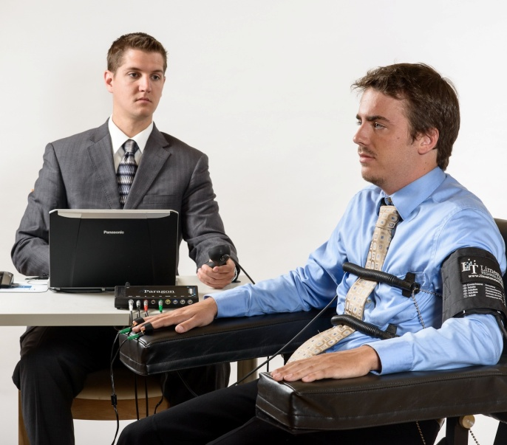
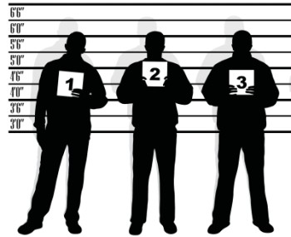
MAINSTREAM PSYCHOLOGY
Placebo Effects
Lie Detectors
Eyewitness Testimony

Slide 17
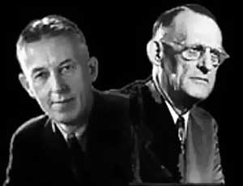
MAINSTREAM PSYCHOLOGY
A.A.
Alcoholics Anonymous
Bill Wilson & Dr. Bob Smith

Slide 18
The 12 Steps
Step 1: “We admitted we were powerless over alcohol, that our lives had become unmanageable.”
Step 2: “Came to believe that a Power greater than ourselves could restore us to sanity.”
Step 3: “Made a decision to turn our will and our lives over to the care of God as we understood God.”
Step 4: “Made a searching and fearless moral inventory of ourselves.”
Step 5: “Admitted to God, to ourselves, and to another human being the exact nature of our wrongs.”
Step 6: “Were entirely ready to have God remove all these defects of character.”
Step 7: “Humbly asked God to remove our shortcomings.”
Step 8: “Made a list of all persons we had harmed and became willing to make amends to them all.”
Step 9: “Made direct amends to such people wherever possible, except when to do so would injure them or others.”
Step 10: “Continued to take personal inventory, and when we were wrong promptly admitted it.”
Step 11: “Sought through prayer and meditation to improve our conscious contact with God as we understood God, praying only for knowledge of God’s will for us and the power to carry that out.”
Step 12: “Having had a spiritual awakening as the result of these steps, we tried to carry this message to other addicts and to practice these principles in all our affairs.”

Slide 19
The 12 Steps
Step 1: “We admitted we were powerless over alcohol, that our lives had become unmanageable.”
Step 2: “Came to believe that a Power greater than ourselves could restore us to sanity.”
Step 3: “Made a decision to turn our will and our lives over to the care of God as we understood God.”
Step 4: “Made a searching and fearless moral inventory of ourselves.”
Step 5: “Admitted to God, to ourselves, and to another human being the exact nature of our wrongs.”
Step 6: “Were entirely ready to have God remove all these defects of character.”
Step 7: “Humbly asked God to remove our shortcomings.”
Step 8: “Made a list of all persons we had harmed and became willing to make amends to them all.”
Step 9: “Made direct amends to such people wherever possible, except when to do so would injure them or others.”
Step 10: “Continued to take personal inventory, and when we were wrong promptly admitted it.”
Step 11: “Sought through prayer and meditation to improve our conscious contact with God as we understood God, praying only for knowledge of God’s will for us and the power to carry that out.”
Step 12: “Having had a spiritual awakening as the result of these steps, we tried to carry this message to other addicts and to practice these principles in all our affairs.”

Slide 20
The 5 C’s (Oxford Group)
1. Confidence: the new person must have confidence in you and know you will keep his secrets.
2. Confession: honesty about the real state of a person’s life.
3. Conviction: admit the seriousness of his sin, and the need to be free of it.
4. Conversion: the process must be of the person’s own free will in the decision to surrender to God.
5. Continuance: you are responsible as a Life Changer to help the new person become all that God wants him to be.

Slide 21
The 12 Steps
Step 1: “We admitted we were powerless over alcohol, that our lives had become unmanageable.”
Step 2: “Came to believe that a Power greater than ourselves could restore us to sanity.”
Step 3: “Made a decision to turn our will and our lives over to the care of God as we understood God.”
Step 4: “Made a searching and fearless moral inventory of ourselves.”
Step 5: “Admitted to God, to ourselves, and to another human being the exact nature of our wrongs.”
Step 6: “Were entirely ready to have God remove all these defects of character.”
Step 7: “Humbly asked God to remove our shortcomings.”
Step 8: “Made a list of all persons we had harmed and became willing to make amends to them all.”
Step 9: “Made direct amends to such people wherever possible, except when to do so would injure them or others.”
Step 10: “Continued to take personal inventory, and when we were wrong promptly admitted it.”
Step 11: “Sought through prayer and meditation to improve our conscious contact with God as we understood God, praying only for knowledge of God’s will for us and the power to carry that out.”
Step 12: “Having had a spiritual awakening as the result of these steps, we tried to carry this message to other addicts and to practice these principles in all our affairs.”

Slide 22
Research on A.A.
Smith (1985, 1986)
78 women (79%)
137 men (61%)
Control group (3%, 5%)
Later evaluation found that A.A. wasn’t the only treatment subjects received.
------------------------------------------------------------------------------------------------------------------------------
Smith, D. I. (1986). Evaluation of a residential AA program for women. Alcohol
and Alcoholism, 20, 315-327.
Smith, D. I. (1985). Evaluation of a residential AA program. International
Journal of the Addictions, 21, 33-49.

Slide 23
Research on A.A.
Toningan, et al. (2000)
Positive treatment outcome was significantly tied to a single factor:
- “clients’ ratings of the conceptual and
spiritual underpinnings of A.A.”
------------------------------------------------------------------------------------------------------------------------------
Toningan, J. W., Miller, W. R, & Connors, G. J. (2000). Project MATCH client impressions
about Alcoholics Anonymous: Measurement issues and relationship to treatment
outcomes. Alcoholism Treatment Quarterly, 18, 25-41.

Slide 24
Research on A.A.

Slide 25
BAD TEACHING

Slide 26
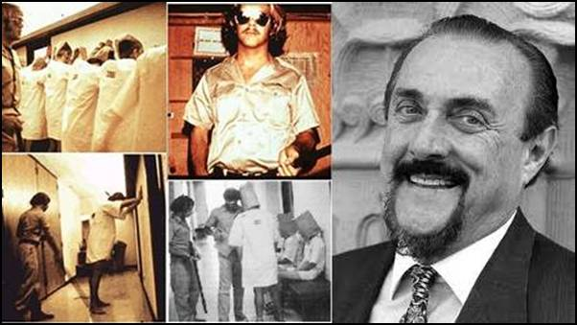
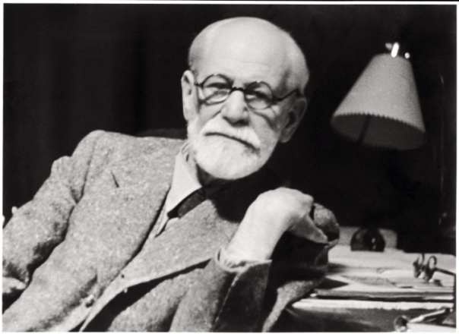
BAD TEACHING
Stanford Prison Study
Sigmund Freud

Slide 27
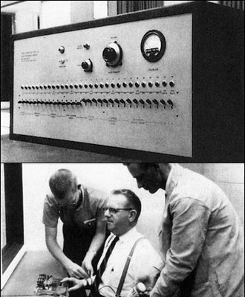
BAD TEACHING
Stanford Prison Study
Sigmund Freud
Milgram Obedience Study

Slide 28
Milgram Obedience Study

Slide 29
2005 Survey of Psych Teachers
Sample of high school and college psychology teachers.
N = 150
“Milgram showed that it is relatively easy to get people to obey orders to hurt someone.” (53% said true)
“Milgram showed that most people have an inherent ‘bad side’ that can lead them to dangerous behaviors.” (24% said true)
In fact, Milgram’s study showed something quite different.

Slide 30
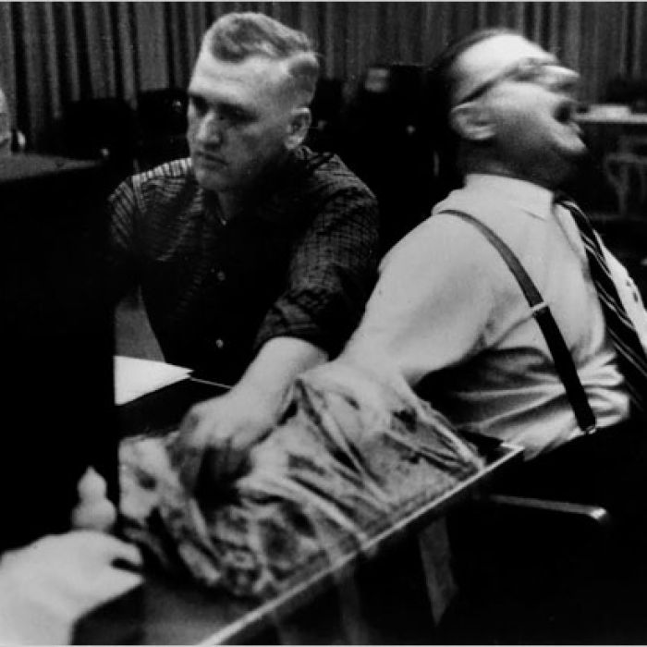
Findings from Milgram Studies
Experimental Environment:
1. Learner in another room, can hear him. (65%)
2. Learner in another room, can’t hear him. (75%)
3. Learner in same room, within a few feet. (40%)
4. Learner in same room, using shock plate. (30%)

Slide 31
Findings from Milgram Studies
Group Dynamics:
In a group of Confederates who began to disagree about whether to follow the orders, obedience dropped to 10%.
Proximity of Authority:
- orders given by phone, 20%
- orders given on tape recorder, 18%
Consistency of Authority:
When two authority figures gave conflicting orders, obedience fell to 0%.

Slide 32
THANK YOU!
(Insert witty, thoughtful ending here.)
www.SheldonHelms.com

